Slide 1
Metrology Design
Project Name:R240
Part Number & Rev：099-53721-08(48 Block Magnets)
Vendor：Magsound
Date：2025/12/08

Slide 2
MTD | R240-Content-099-53721-08
Cover sheet | Page 1
Content | Page 2
BOM List | Page 3-4
Measurement Equipment Details | Page 5-14
Measurement Fixture List | Page 15
Details for Each Measurement | Page 16-36

Slide 3
MTD | R240 Part List 099-53721-08
No. | APNs | FAI1/SPCA X-(mm) | FAI2/SPCB Y-(mm) | FAI3/SPCC Z-(mm) | FAI4/SPCD (μWb*cm) | FAI5/SPCE ±7° Magnetization angle | 4*FAI6 (mm) Short Edge Radius | 8*FAI7 (mm) Long Edge Radius | Material | Br(KGs) | Hcb(KOe) | HcJ(KOe) | BH Max(MGOe) | Plating Thickness(μm)
1 | 160-05846 | 10.17 | 4.55 | 0.9 | 4.65~5.45 | 55° ΘYZ | 0.2 +0.1/-0.08 | Max 0.2 | N42SH-100RC | 12.8~13.2 | / | 20MIN | 40~43 | Zinc:6-14
2 | 160-05847 | 5.69 | 5.8 | 0.9 | 3.31~3.89 | 55° ΘYZ | 0.2 +0.1/-0.08 | Max 0.2 | N42SH-100RC | 12.8~13.2 | / | 20MIN | 40~43 | Zinc:6-14
3 | 160-05849 | 5.96 | 4.55 | 0.9 | 2.49~2.93 | 55° ΘYZ | 0.2 +0.1/-0.08 | Max 0.2 | N35SH-100RC | 11.7~12.2 | / | 20MIN | 33~36 | Zinc:6-14
4 | 160-05851 | 12.38 | 4.55 | 0.9 | 5.19~6.09 | 55° ΘYZ | 0.2 +0.1/-0.08 | Max 0.2 | N35SH-100RC | 11.7~12.2 | / | 20MIN | 33~36 | Zinc:6-14
5 | 160-05844 | 5.18 | 5.8 | 0.9 | 3.02~3.54 | 55° ΘYZ | 0.2 +0.1/-0.08 | Max 0.2 | N42SH-100RC | 12.8~13.2 | / | 20MIN | 40~43 | Zinc:6-14
6 | 160-05852 | 4.7 | 5.8 | 0.9 | 2.73~3.21 | 55° ΘYZ | 0.2 +0.1/-0.08 | Max 0.2 | N42SH-100RC | 12.8~13.2 | / | 20MIN | 40~43 | Zinc:6-14
7 | 160-05850 | 11.2 | 5.8 | 0.9 | 6.54~7.68 | 55° ΘYZ | 0.2 +0.1/-0.08 | Max 0.2 | N42SH-100RC | 12.8~13.2 | / | 20MIN | 40~43 | Zinc:6-14
8 | 160-05848 | 12.56 | 4.55 | 0.9 | 5.26~6.18 | 55° ΘYZ | 0.2 +0.1/-0.08 | Max 0.2 | N35SH-100RC | 11.7~12.2 | / | 20MIN | 33~36 | Zinc:6-14
9 | 160-05845 | 11.41 | 4.55 | 0.9 | 4.78~5.62 | 55° ΘYZ | 0.2 +0.1/-0.08 | Max 0.2 | N35SH-100RC | 11.7~12.2 | / | 20MIN | 33~36 | Zinc:6-14
10 | 160-05549 | 8.7 | 8.85 | 0.8 | 3.04~3.57 | / | 0.25 ±0.1 | Max 0.2 | GPM-12H | 7.2~8.0 | 5.5~6.5 | 9.0~10.0 | 11.0~12.0 | Epoxy:10-20
11 | 160-05550 | 9 | 20.28 | 0.8 | 6.46~7.58 | / | 0.25 ±0.1 | Max 0.2 | GPM-8 | 6.0~6.8 | 4.5~5.5 | 8.0~10.0 | 7.5~9.0 | Epoxy:10-20
13 | 160-05552 | 6.86 | 8.85 | 0.8 | 2.39~2.80 | / | 0.25 ±0.1 | Max 0.2 | GPM-12H | 7.2~8.0 | 5.5~6.5 | 9.0~10.0 | 11.0~12.0 | Epoxy:10-20
14 | 160-05553 | 4.06 | 8.85 | 0.8 | 1.43~1.67 | / | 0.25 ±0.1 | Max 0.2 | GPM-12H | 7.2~8.0 | 5.5~6.5 | 9.0~10.0 | 11.0~12.0 | Epoxy:10-20
15 | 160-05554 | 12 | 10.05 | 0.7 | 8.66~10.17 | 90° Θz | 0.2 +0.1/-0.08 | Max 0.2 | N35SH-100RC | 11.7~12.2 | / | 20MIN | 33~36 | Zinc:6-14
16 | 160-05555 | 8 | 10 | 0.8 | 6.66~7.82 | 90° Θz | 0.2 +0.1/-0.08 | Max 0.2 | N35SH-100RC | 11.7~12.2 | / | 20MIN | 33~36 | Zinc:6-14
17 | 160-05556 | 5.46 | 8.85 | 0.8 | 1.93~2.26 | / | 0.25 ±0.1 | Max 0.2 | GPM-12H | 7.2~8.0 | 5.5~6.5 | 9.0~10.0 | 11.0~12.0 | Epoxy:10-20
18 | 160-05842 | 15.58 | 5.8 | 0.7 | 3.13~3.67 | / | 0.25 ±0.1 | Max 0.2 | GPM-12H | 7.2~8.0 | 5.5~6.5 | 9.0~10.0 | 11.0~12.0 | Epoxy:10-20
19 | 160-05843 | 20.79 | 5.8 | 0.7 | 4.17~4.89 | / | 0.25 ±0.1 | Max 0.2 | GPM-12H | 7.2~8.0 | 5.5~6.5 | 9.0~10.0 | 11.0~12.0 | Epoxy:10-20
20 | 160-05861 | 9.15 | 6.2 | 1.15 | 7.71~9.05 | 160° ΘYZ | 0.2 +0.1/-0.08 | Max 0.2 | N45SH-100RC | 13.2~13.8 | / | 20MIN | 42.98~45.99 | Zinc:6-14
21 | 160-05857 | 5.69 | 6.2 | 1.15 | 4.78~5.62 | 160° ΘYZ | 0.2 +0.1/-0.08 | Max 0.2 | N45SH-100RC | 13.2~13.8 | / | 20MIN | 42.98~45.99 | Zinc:6-14
22 | 160-05858 | 5.95 | 6.2 | 1.15 | 5.00~5.88 | 160° ΘYZ | 0.2 +0.1/-0.08 | Max 0.2 | N45SH-100RC | 13.2~13.8 | / | 20MIN | 42.98~45.99 | Zinc:6-14
23 | 160-05859 | 12.38 | 6.2 | 1.15 | 10.45~12.27 | 160° ΘYZ | 0.2 +0.1/-0.08 | Max 0.2 | N45SH-100RC | 13.2~13.8 | / | 20MIN | 42.98~45.99 | Zinc:6-14
24 | 160-05860 | 5.18 | 6.2 | 1.15 | 4.35~5.11 | 160° ΘYZ | 0.2 +0.1/-0.08 | Max 0.2 | N45SH-100RC | 13.2~13.8 | / | 20MIN | 42.98~45.99 | Zinc:6-14
25 | 160-05855 | 4.7 | 6.2 | 1.15 | 3.95~4.63 | 160° ΘYZ | 0.2 +0.1/-0.08 | Max 0.2 | N45SH-100RC | 13.2~13.8 | / | 20MIN | 42.98~45.99 | Zinc:6-14
26 | 160-05856 | 11.2 | 6.2 | 1.15 | 9.45~11.09 | 160° ΘYZ | 0.2 +0.1/-0.08 | Max 0.2 | N45SH-100RC | 13.2~13.8 | / | 20MIN | 42.98~45.99 | Zinc:6-14

Slide 4
MTD | R240 Part List 099-53721-08
No. | APNs | FAI1/SPCA X-(mm) | FAI2/SPCB Y-(mm) | FAI3/SPCC Z-(mm) | FAI4/SPCD (μWb*cm) | FAI5/SPCE ±7° Magnetization angle | 4*FAI6 (mm) Short Edge Radius | 8*FAI7 (mm) Long Edge Radius | Material | Br(KGs) | Hcb(KOe) | HcJ(KOe) | BH Max(MGOe) | Plating Thickness(μm)
27 | 160-05853 | 12.56 | 6.2 | 1.15 | 10.60~12.44 | 160° ΘYZ | 0.2 +0.1/-0.08 | Max 0.2 | N45SH-100RC | 13.2~13.8 | / | 20MIN | 42.98~45.99 | Zinc:6-14
28 | 160-05854 | 11.41 | 3.67 | 1.15 | 5.65~6.63 | 160° ΘYZ | 0.2 +0.1/-0.08 | Max 0.2 | N45SH-100RC | 13.2~13.8 | / | 20MIN | 42.98~45.99 | Zinc:6-14
29 | 160-05841 | 11.85 | 3.8 | 0.8 | 3.62~4.26 | 90° Θz | 0.2 +0.1/-0.08 | Max 0.2 | N35SH-100RC | 11.7~12.2 | / | 20MIN | 33~36 | Zinc:6-14
30 | 160-05570 | 7 | 4 | 0.8 | 2.32~2.72 | 90° Θz | 0.2 +0.1/-0.08 | Max 0.2 | N35SH-100RC | 11.7~12.2 | / | 20MIN | 33~36 | Zinc:6-14
31 | 160-05571 | 12 | 11 | 0.8 | 5.15~6.04 | / | 0.25 ±0.1 | Max 0.2 | GPM-12H | 7.2~8.0 | 5.5~6.5 | 9.0~10.0 | 11.0~12.0 | Epoxy:10-20
32 | 160-05748 | 3.5 | 12.85 | 1.1 | 3.02~2.58 | / | 0.25 ±0.1 | Max 0.2 | GPM-12H | 7.2~8.0 | 5.5~6.5 | 9.0~10.0 | 11.0~12.0 | Epoxy:10-20
33 | 160-05744 | 9.35 | 5.5 | 1.1 | 3.43~2.93 | / | 0.25 ±0.1 | Max 0.2 | GPM-12H | 7.2~8.0 | 5.5~6.5 | 9.0~10.0 | 11.0~12.0 | Epoxy:10-20
34 | 160-06672 | 9 | 10.15 | 0.8 | 2.95~3.423 | / | 0.25 ±0.1 | Max 0.2 | GPM-8 | 6.0~6.8 | 4.5~5.5 | 8.0~10.0 | 7.5~9.0 | Epoxy:10-20
35 | 160-06671 | 9 | 18.28 | 0.8 | 5.03~5.91 | / | 0.25 ±0.1 | Max 0.2 | GPM-8 | 6.0~6.8 | 4.5~5.5 | 8.0~10.0 | 7.5~9.0 | Epoxy:10-20
38 | 160-05583 | 8.7 | 3.5 | 0.8 | 2.49~2.92 | 90° Θz | 0.2 +0.1/-0.08 | Max 0.2 | N35SH-100RC | 11.7~12.2 | / | 20MIN | 33~36 | Zinc:6-14
39 | 160-05584 | 6.86 | 3.5 | 0.8 | 1.98~2.33 | 90° Θz | 0.2 +0.1/-0.08 | Max 0.2 | N35SH-100RC | 11.7~12.2 | / | 20MIN | 33~36 | Zinc:6-14
40 | 160-05585 | 4.06 | 3.5 | 0.8 | 1.17~1.37 | 90° Θz | 0.2 +0.1/-0.08 | Max 0.2 | N35SH-100RC | 11.7~12.2 | / | 20MIN | 33~36 | Zinc:6-14
41 | 160-05586 | 2.3 | 3.5 | 0.8 | 0.65~0.76 | 90° Θz | 0.2 +0.1/-0.08 | Max 0.2 | N35SH-100RC | 11.7~12.2 | / | 20MIN | 33~36 | Zinc:6-14
42 | 160-05587 | 5.46 | 3.5 | 0.8 | 1.57~1.85 | 90° Θz | 0.2 +0.1/-0.08 | Max 0.2 | N35SH-100RC | 11.7~12.2 | / | 20MIN | 33~36 | Zinc:6-14
43 | 160-05589 | 8 | 5.8 | 0.8 | 4.24~4.97 | 90° Θz | 0.2 +0.1/-0.08 | Max 0.2 | N45SH-100RC | 13.2~13.8 | / | 20MIN | 42.98~45.99 | Zinc:6-14
44 | 160-05590 | 4.5 | 5.8 | 0.8 | 2.38~2.80 | 90° Θz | 0.2 +0.1/-0.08 | Max 0.2 | N45SH-100RC | 13.2~13.8 | / | 20MIN | 42.98~45.99 | Zinc:6-14
45 | 160-05750 | 7 | 5.8 | 0.8 | 3.68~4.32 | 90° Θz | 0.2 +0.1/-0.08 | Max 0.2 | N45SH-100RC | 13.2~13.8 | / | 20MIN | 42.98~45.99 | Zinc:6-14
46 | 160-05592 | 2.8 | 5.8 | 0.8 | 1.47~1.73 | 90° Θz | 0.2 +0.1/-0.08 | Max 0.2 | N45SH-100RC | 13.2~13.8 | / | 20MIN | 42.98~45.99 | Zinc:6-14
47 | 160-05593 | 10.5 | 5.8 | 0.8 | 5.59~6.56 | 90° Θz | 0.2 +0.1/-0.08 | Max 0.2 | N45SH-100RC | 13.2~13.8 | / | 20MIN | 42.98~45.99 | Zinc:6-14
48 | 160-05752 | 11 | 5.8 | 0.8 | 6.8~5.8 | 90° Θz | 0.2 +0.1/-0.08 | Max 0.2 | N45SH-100RC | 13.2~13.8 | / | 20MIN | 42.98~45.99 | Zinc:6-14
49 | 160-05557 | 3.5 | 3.5 | 0.8 | 0.99~1.17 | 90° Θz | 0.2 +0.1/-0.08 | Max 0.2 | N35SH-100RC | 11.7~12.2 | / | 20MIN | 33~36 | Zinc:6-14
50 | 160-05755 | 3.5 | 12.85 | 0.8 | 1.84~2.16 | / | 0.25 ±0.1 | Max 0.2 | GPM-12H | 7.2~8.0 | 5.5~6.5 | 9.0~10.0 | 11.0~12.0 | Epoxy:10-20
51 | 160-05756 | 9.35 | 5.5 | 0.8 | 2.09~2.45 | / | 0.25 ±0.1 | Max 0.2 | GPM-12H | 7.2~8.0 | 5.5~6.5 | 9.0~10.0 | 11.0~12.0 | Epoxy:10-20

Slide 5
MTD | R240 Measurement Equipment Details-Keyence
Name: | KEYENCE
Manufacturer: | KEYENCE
Model: | IM7010
Image pickup device: | 1#6.6 mega pixel monochrome CMOS
Display: | 10.4# LCD monitor
Light receiving lens: | Double telecentric lens
Field of view: | Wide-field measurement mode Φ100x200mm
 | High-precision measurement mode Φ25x125mm
Minimum display unit: | 0.1μm
Repetition Accuracy: | Wide-field measurement mode: | W/0 Stage Movement: ±1μm
 |  | With Stage Movement: ±2μm
 | High-precision measurement mode: | W/0 Stage Movement: ±0.5μm
 |  | With Stage Movement: ±1.5μm
Measurement Accuracy: | Wide-field measurement mode: | W/0 Stage Movement: ±5μm
 |  | With Stage Movement: ±(7+0.01L)μm
 | High-precision measurement mode: | W/0 Stage Movement: ±2μm
 |  | With Stage Movement: ±(4+0.01L)μm

Slide 6
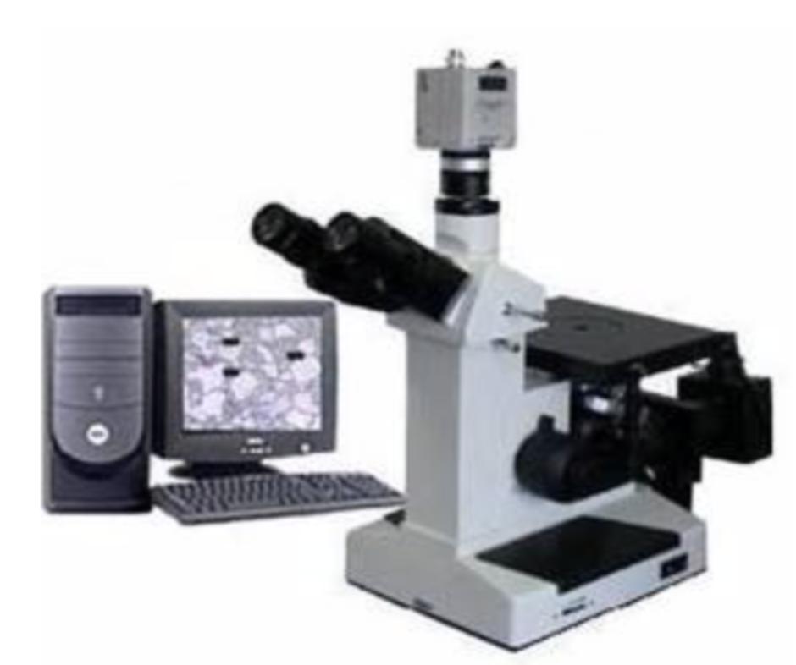
MTD | R240 Measurement Equipment Details –Metallographic Microscope
Name: | Metallographic Microscope
Manufacturer: | Shanghai Optical Instrument Factory
Model: | 4XC-MS
Resolution: | 0.01μm
Magnification: | Zoom | 600X
 | Pixel | 20 million
Illumination System: | Halogen lamp 20W/6V

Slide 7
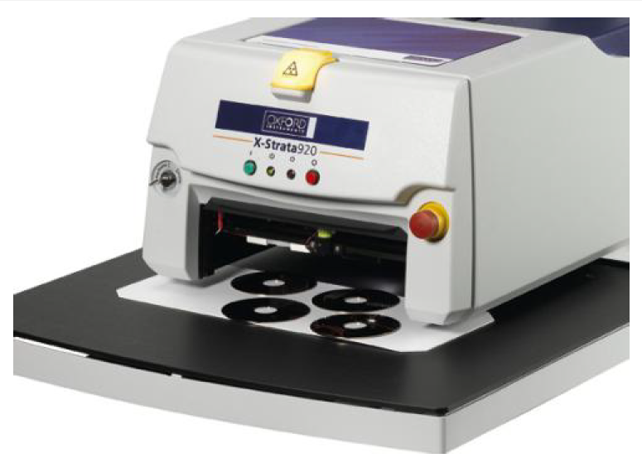
MTD | R240 Dimensions Measurement-XRF
Name: | X-ray fluorescence coating thickness gauge
Brand: | HITACHI
Model: | X-Strata920自动仪
Range of measuring: | XYZ:15.24*17.78*43mm
Straightener: | Ø0.2mm
Light tube power： | 50W
Range of measurement： | Non-destructive EDXRF analysis
Applicable Products： | Within 4 layers (plus substrate) total thickness <20um plating species
Quantity： | 2

Slide 8
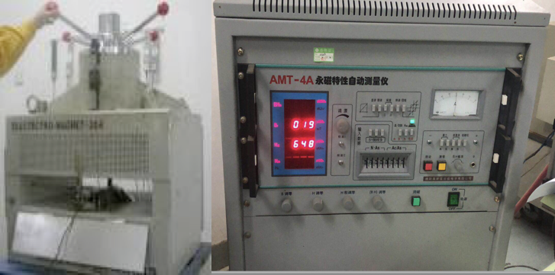
MTD | R240 Measurement Equipment Details-Magnetic permanent tester
Name: | Magnetic permanent tester
Manufacturer: | Sheep
Model: | AMT-4A
Range: | Min: 10*10*10mm
Accuracy: | NA

Slide 9
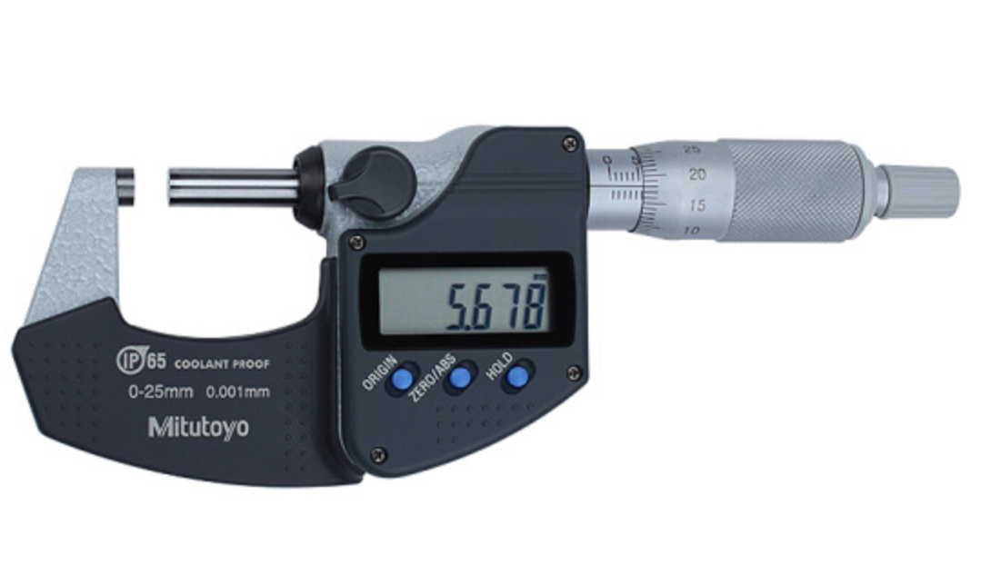
MTD | R240 Measurement Equipment Details -Mic
Name: | MIC
Manufacturer: | Mitutoyo
Model: | MDC-25MX
Measuring Stroke: | 0-25mm
Measurement Accuracy: | 0.001 mm

Slide 10
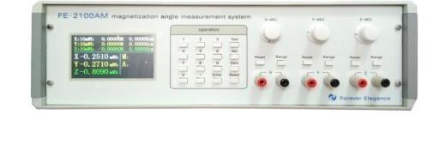
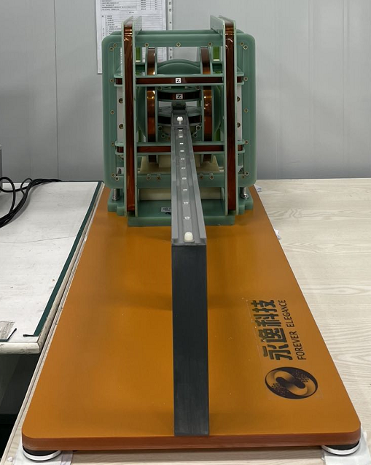
MTD | R240 Measurement Equipment Details-(3D Axis) Fluxmeter
Name: | (3D Axis) Fluxmeter
Manufacturer: | HuNan YongYi TechnologyCo.,Ltd / HNYY
Model: | Fluxmeter Model：FE-2100AM Coil Model：FE-3HM100
Range: | Magnetic moment 0.1-499.9 μWb*cm
Accuracy: | ±0.5%

Slide 11
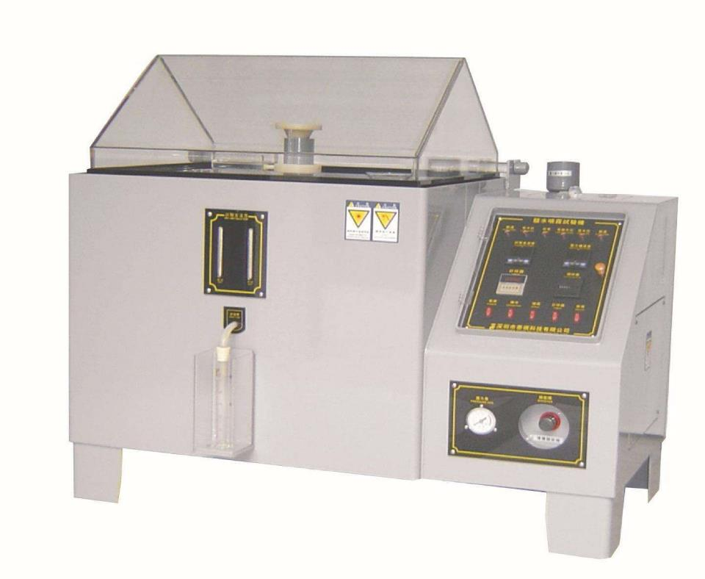
MTD | R240 Measurement Equipment Details-SST
Name: | SST Tester
Manufacturer: | Ningbo Yuanming
Model: | YM-90
Tester Container: | 900*600*500mm
Spray quantity | 1.0-2.0ml/h
Salt water volume | 25L

Slide 12
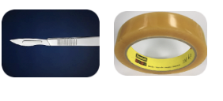
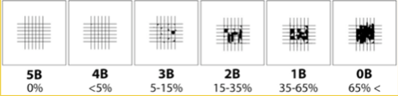
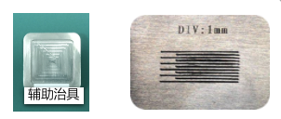
MTD | R240 Measurement Equipment Details-Cross Hatch Test
Name : | Cross Hatch Test
Tools： | Bagel knife +3M610 tape
ASTM grade：
Purpose： | Check the adhesion of the coating to the substrate

Slide 13
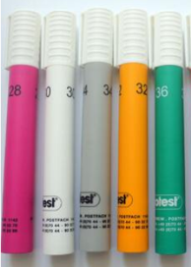
MTD | R240 Measurement Equipment Details-Dyne Test
Name: | Dyne Test
Model: | Dyne pen 34#

Slide 14
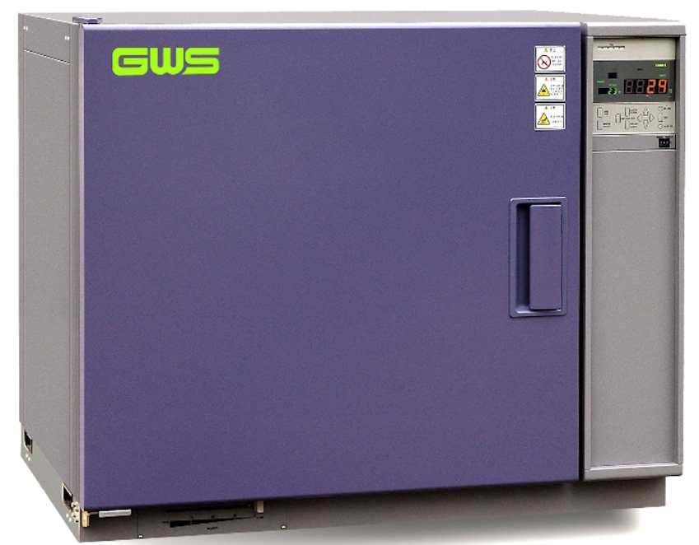
MTD | R240 Measurement Equipment Details-Thermal and Heat chamber
Name: | Oven
Manufacturer: | Guangzhou Wusuo
Model: | PHH101
Range: | 0℃ +250℃
Accuracy: | ±2℃

Slide 15
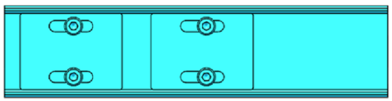
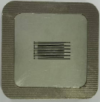
MTD | R240 Measurement Fixture List
Fixture No | Size | Material | Pic | Remark
J-R240-1# | 100*35.4*8 | Electric board |  | /
J-R240-2# | 60*60*10 | USU304 |  | Cross Hatch

Slide 16
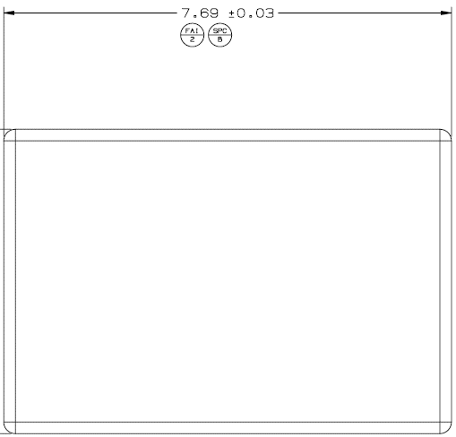

MTD | R240 Metrology Details-Magnet 099-53721-08
MAGNET Length: FAI1/SPCA±0.05
CPK | In-process
1. Measurement Method ：Keyence 2. Fixture ：/ 3. Measurement status ：Free 4. Measurement procedure： 将磁钢平面朝下摆放; 选择“线-线距离”功能，自动选取直线L1和L2； (边缘避开0.5*0.5mm); 在L1和L2两条线之间得到长度为FAI1. a. Place the magnet with flat surface downwards; b. Select the function of “line-line” , select two lines L1 and L2 automatically; (Edge avoid 0.5*0.5mm); c. The length between L1 and L2 is FAI1. | 1. Measurement Method ：Keyence 2. Fixture ：/ 3. Measurement status ：Free 4. Measurement procedure ：Same as the CPK
No. | FAI1/SPCA |  | No. | FAI1/SPCA
1 | 10.17 |  | 26 | 11.2
2 | 5.69 |  | 27 | 12.56
3 | 5.96 |  | 28 | 11.41
4 | 12.38 |  | 29 | 11.85
5 | 5.18 |  | 30 | 7
6 | 4.7 |  | 31 | 12
7 | 11.2 |  | 32 | 3.5
8 | 12.56 |  | 33 | 9.35
9 | 11.41 |  | 34 | 9
10 | 8.7 |  | 35 | 9
11 | 9 |  | 38 | 8.7
13 | 6.86 |  | 39 | 6.86
14 | 4.06 |  | 40 | 4.06
15 | 12 |  | 41 | 2.3
16 | 8 |  | 42 | 5.46
17 | 5.46 |  | 43 | 8
18 | 15.58 |  | 44 | 4.5
19 | 20.79 |  | 45 | 7
20 | 9.15 |  | 46 | 2.8
21 | 5.69 |  | 47 | 10.5
22 | 5.95 |  | 48 | 11
23 | 12.38 |  | 49 | 3.5
24 | 5.18 |  | 50 | 3.5
25 | 4.7 |  | 51 | 9.35
FAI1/SPCA±0.05
0.5mm
0.5mm
L1
L2
0.5mm
0.5mm

Slide 17
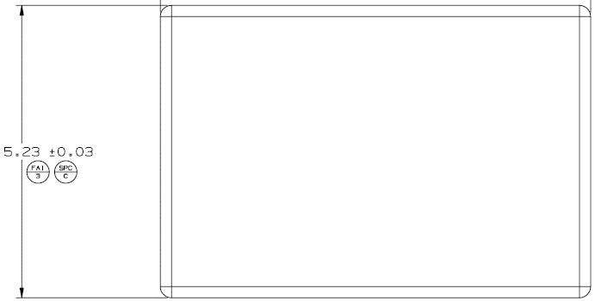
MTD | R240 Metrology Details-Magnet 099-53721-08
MAGNET Distance: FAI2/SPCB±0.05
CPK | In-process
1. Measurement method ：Keyence 2. Fixture ：/ 3. Measurement status ：Free 4. Measurement procedure： 将磁钢平面朝下摆放; 选择“线-线距离”功能，自动选取直线L3和L4； (边缘避开0.5*0.5mm); 在L3和L4两条线之间得到宽度为FAI2. a. Place the magnet with flat surface downwards; b. Select the function of “line-line” , select two lines L3 and L4 automatically; (Edge avoid 0.5*0.5mm); c. The width between L3 and L4 is FAI2. | 1. Measurement method ：Keyence 2. Fixture ：/ 3. Measurement status ：Free 4. Measurement procedure ：same as the CPK
No. | FAI2/SPCB |  | No. | FAI2/SPCB
1 | 4.55 |  | 26 | 6.2
2 | 5.8 |  | 27 | 6.2
3 | 4.55 |  | 28 | 3.67
4 | 4.55 |  | 29 | 3.8
5 | 5.8 |  | 30 | 4
6 | 5.8 |  | 31 | 11
7 | 5.8 |  | 32 | 12.85
8 | 4.55 |  | 33 | 5.5
9 | 4.55 |  | 34 | 10.15
10 | 8.85 |  | 35 | 18.28
11 | 20.28 |  | 38 | 3.5
13 | 8.85 |  | 39 | 3.5
14 | 8.85 |  | 40 | 3.5
15 | 10.05 |  | 41 | 3.5
16 | 10 |  | 42 | 3.5
17 | 8.85 |  | 43 | 5.8
18 | 5.8 |  | 44 | 5.8
19 | 5.8 |  | 45 | 5.8
20 | 6.2 |  | 46 | 5.8
21 | 6.2 |  | 47 | 5.8
22 | 6.2 |  | 48 | 5.8
23 | 6.2 |  | 49 | 3.5
24 | 6.2 |  | 50 | 12.85
25 | 6.2 |  | 51 | 5.5
0.5mm
L3
0.5mm
FAI2/SPCB±0.05
L4
0.5mm
0.5mm

Slide 18
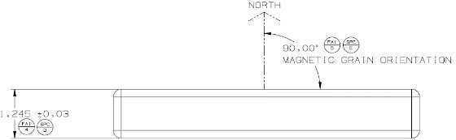
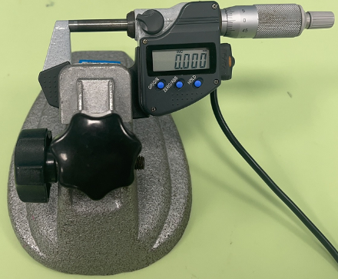
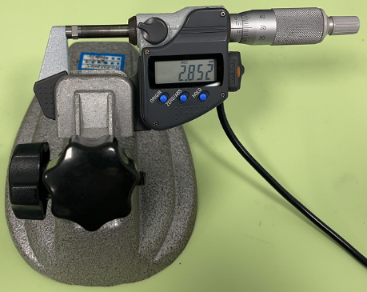

MTD | R240 Metrology Details-Magnet 099-53721-08
MAGNET Thickness: FAI3/SPCC±0.04
CPK | In-process
1. Measurement method ：MIC 2. Fixture ：/ 3. Measurement status ：free 4. Measurement procedure： a.将千分尺归零;(pic1) b.将产品点一平面平放在千分尺的测砧上，转动测微螺杆，使螺杆慢慢靠近产品表面，转动旋测力装置，听到3次咔咔声后停止测试，记录数据; a. Return the micrometer to zero; (pic1) b. Place the point of the product flat on the measuring anvil of the micrometer, rotate the micro measuring screw, so that the screw is slowly close to the surface of the product, rotate the rotary force measuring device, stop the test after hearing 3 clicks, and record the data; | 1. Measurement method ：MIC 2. Fixture ：/ 3. Measurement status ：free 4. Measurement procedure ：same as the CPK
No. | FAI3/SPCC |  | No. | FAI3/SPCC
1 | 0.9 |  | 26 | 1.15
2 | 0.9 |  | 27 | 1.15
3 | 0.9 |  | 28 | 1.15
4 | 0.9 |  | 29 | 0.8
5 | 0.9 |  | 30 | 0.8
6 | 0.9 |  | 31 | 0.8
7 | 0.9 |  | 32 | 1.1
8 | 0.9 |  | 33 | 1.1
9 | 0.9 |  | 34 | 0.8
10 | 0.8 |  | 35 | 0.8
11 | 0.8 |  | 38 | 0.8
13 | 0.8 |  | 39 | 0.8
14 | 0.8 |  | 40 | 0.8
15 | 0.7 |  | 41 | 0.8
16 | 0.8 |  | 42 | 0.8
17 | 0.8 |  | 43 | 0.8
18 | 0.7 |  | 44 | 0.8
19 | 0.7 |  | 45 | 0.8
20 | 1.15 |  | 46 | 0.8
21 | 1.15 |  | 47 | 0.8
22 | 1.15 |  | 48 | 0.8
23 | 1.15 |  | 49 | 0.8
24 | 1.15 |  | 50 | 0.8
25 | 1.15 |  | 51 | 0.8
Thickness±0.04
*NOTE:尺寸长度或宽度在7mm以内(含7mm)测量一个值，
超过7mm~15mm（含15mm）的测量两个值（边缘与中心两个位置）
超过15mm 的测量三个值（2*边缘与中心两个位置）
Magnet
6.5mm
0.900
6.5mm
6.5mm
Pic 1. return to Zero
Pic 2.Test
Pic 3.Test location

Slide 19


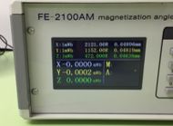


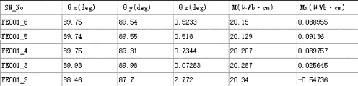



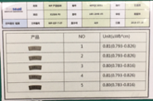
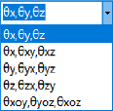


MTD | R240 Metrology Details-Magnet 099-53721-08
MAGNET MOMENT :FAI4/SPCD μWb*cm
CPK | In-process
1 . Measurement Method ：Three-dimensional coil tester 2. Fixture ：J-R240-1# 3. Measurement status ：Constrained 4. Measurement procedure ： a.校正： 1)打开设备电源开关，预热15分钟，调节面板的X-ADJ，Y-ADJ，Z-ADJ分别使数据跳动幅度 变小，1秒内跳动0.0005mWb即判定调漂完成(Pic1) ； 2）标样放在测试治具上,治具放入线圈中,先按红色的“Rest”键,使XYZ读数清零;再按”Zero”键归零(Pic2) ，将产品水平拉出线圈600mm外,按“Test”测出结果； 3）标样磁矩标准公差±0.3%(Pic3) ； 4）再测试标样Q1-Q5磁矩值在表1波动范围内(Pic4) ，方可正式测试. b.夹具和产品放置： 使用夹具1(Pic5) 将产品嵌入到轮廓内(Pic6) c.测量： 先按红色的“Rest”键，使XYZ读数清零；再按“Zero”键归零，将产品水平拉出线圈600mm外(Pic7) ，按“Test”测出结果，记录MM值-单位uWb*cm(Pic8) ； d.重点事项：至少2.5 米内不可有电子设备，磁性材料，金属等。 a.Calibration: 1) Turn on the power switch of the equipment, preheat for 15 minutes, and adjust the X-ADJ, Y-ADJ and Z-ADJ of the panel to reduce the data jump amplitude. Judging that the adjustment is completed by 0.0005 mWb in one second (Pic. 1); 2) Put the standard sample on the test fixture, put it in the coil, press the red "Rest" key first, make the XYZ reading clear; and then press the "Zero" button. Keyboard to zero (Pic 2). Pull the product out of the coil 600 mm horizontally and measure the result according to "Test". 3) Standard tolerance of magnetic moment of standard sample (±0.3%) (Pic 3); 4) Test the value of magnetic moment of standard sample Q1-Q5 within the fluctuation range of Table 1 (Pic 4), before formal test. b.Fixture and product placement: Use Fixture 1 (Pic. 5) to insert the product into the contour (Pic. 6) c.Measurement: First press the red "Rest" key to clear the XYZ reading; then press the "Zero" key to zero, pull the product out of the coil 600 mm (Pic. 7), press "Test" to measure the results, record the MM value-Unit uWb*cm (Pic. 8) d.Key points:No electronic equipment, magnetic materials, metals, etc. shall be available | 1 . Measurement Method ：Three Axis Fluxmeter+ Helmholtz coil 2. Fixture ：J-R240-1# 3. Measurement status ：Constrained 4. Measurement procedure ：Same as the CPK
No. | FAI4/SPCD(μWb*cm |  | No. | FAI4/SPCD(μWb*cm
1 | 4.65~5.45 |  | 26 | 9.45~11.09
2 | 3.31~3.89 |  | 27 | 10.60~12.44
3 | 2.49~2.93 |  | 28 | 5.65~6.63
4 | 5.19~6.09 |  | 29 | 3.62~4.26
5 | 3.02~3.54 |  | 30 | 2.32~2.72
6 | 2.73~3.21 |  | 31 | 5.15~6.04
7 | 6.54~7.68 |  | 32 | 3.02~2.58
8 | 5.26~6.18 |  | 33 | 3.43~2.93
9 | 4.78~5.62 |  | 34 | 2.95~3.423
10 | 3.04~3.57 |  | 35 | 5.03~5.91
11 | 6.46~7.58 |  | 38 | 2.49~2.92
13 | 2.39~2.80 |  | 39 | 1.98~2.33
14 | 1.43~1.67 |  | 40 | 1.17~1.37
15 | 8.66~10.17 |  | 41 | 0.65~0.76
16 | 6.66~7.82 |  | 42 | 1.57~1.85
17 | 1.93~2.26 |  | 43 | 4.24~4.97
18 | 3.13~3.67 |  | 44 | 2.38~2.80
19 | 4.17~4.89 |  | 45 | 3.68~4.32
20 | 7.71~9.05 |  | 46 | 1.47~1.73
21 | 4.78~5.62 |  | 47 | 5.59~6.56
22 | 5.00~5.88 |  | 48 | 6.8~5.8
23 | 10.45~12.27 |  | 49 | 0.99~1.17
24 | 4.35~5.11 |  | 50 | 1.84~2.16
25 | 3.95~4.63 |  | 51 | 2.09~2.45
Y
Z
Y尺寸
Z尺寸
X
X尺寸
Pic9.Z方向充磁Apns摆放图示
(充成单极测试,X尺寸对齐X轴,Y尺寸对齐Y轴,N极朝Z+方向)
Calibration
Measurement
Y+
≥600mm
Y
X-
X
X+
角度选择
（选择θx，θy，θz）
Pic 1: X/Y/Z Drift<0.0005mWb
Pic 2 Test keys
Pic 3 Standard Data
Pic 4 Gold Sample
Y-
Pic 8 Data
Pic5 Fixture1
Directionality
Pic6 Put in magnet
Pic 7 Horizontal pull-out>600mm

Slide 20
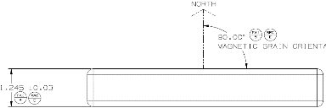

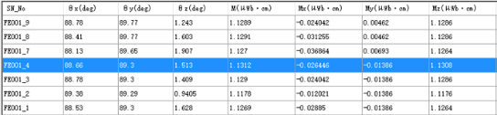



MTD | R240 Metrology Details-Magnet 099-53721-08
Magnetic Orientation: FAI5/SPCE±7°
CPK | In-process
1. Measurement Method ：Three-dimensional coil tester 2. Fixture ：J-R240-1# 3. Measurement status ：Constrained 4. Measurement procedure： a.校正：1)打开设备电源开关，预热15分钟，调节面板的X-ADJ，Y-ADJ，Z-ADJ分别使数据跳动幅度变小，1秒内跳动0.0005mWb即判定调漂完成(Pic1) ； 2）标样放在测试治具上,治具放入线圈中,先按红色的“Rest”键,使XYZ读数清零;再按”Zero”键归零(Pic2) ，将产品水平拉出线圈600mm外,按“Test”测出结果；3）标样磁矩标准公差±0.3%(Pic3) ；4）再测试标样Q1-Q5磁矩值在表1波动范围内(Pic4) ，方可正式测试. b.夹具和产品放置：使用夹具1(Pic5) 将产品嵌入到轮廓内(Pic6) c.测量：先按红色的“Rest”键，使XYZ读数清零；再按“Zero”键归零，将产品水平拉出线圈600mm外(Pic7) ，按“Test”测出结果， (pic 8) d.重点事项：至少2.5 米内不可有电子设备，磁性材料，金属等。 a.Calibration: 1) Turn on the power switch of the equipment, preheat for 15 minutes, and adjust the X-ADJ, Y-ADJ and Z-ADJ of the panel to reduce the data jump amplitude. Judging that the adjustment is completed by 0.0005 mWb in one second (Pic. 1); 2) Put the standard sample on the test fixture, put it in the coil, press the red "Rest" key first, make the XYZ reading clear; and then press the "Zero" button. Keyboard to zero (Pic 2). Pull the product out of the coil 600 mm horizontally and measure the result according to "Test". 3) Standard tolerance of magnetic moment of standard sample (±0.3%) (Pic 3); 4) Test the value of magnetic moment of standard sample Q1-Q5 within the fluctuation range of Table 1 (Pic 4), before formal test. b.Fixture and product placement: Use Fixture 1 (Pic. 5) to insert the product into the contour (Pic. 6) c. Measurement: Press the red "Rest" key to clear the XYZ reading; Then press the "Zero" key to zero, pull the product out of the coil 600mm (Pic7) horizontally, and press "Test" to measure the results, (pic 8) d.Key points:No electronic equipment, magnetic materials, metals, etc. shall be available | 1. Measurement Method ：Three-dimensional coil tester 2. Fixture ：J-R240-1# 3. Measurement status ：Constrained 4. Measurement procedure ：Same as the CPK
No. | FAI5/SPCE Magnetization angle |  | No. | FAI5/SPCE Magnetization angle
1 | 55° ΘYZ |  | 26 | 160° ΘYZ
2 | 55° ΘYZ |  | 27 | 160° ΘYZ
3 | 55° ΘYZ |  | 28 | 160° ΘYZ
4 | 55° ΘYZ |  | 29 | 90° Θz
5 | 55° ΘYZ |  | 30 | 90° Θz
6 | 55° ΘYZ |  | 31 | /
7 | 55° ΘYZ |  | 32 | /
8 | 55° ΘYZ |  | 33 | /
9 | 55° ΘYZ |  | 34 | /
10 | / |  | 35 | /
11 | / |  | 38 | 90° Θz
13 | / |  | 39 | 90° Θz
14 | / |  | 40 | 90° Θz
15 | 90° Θz |  | 41 | 90° Θz
16 | 90° Θz |  | 42 | 90° Θz
17 | / |  | 43 | 90° Θz
18 | / |  | 44 | 90° Θz
19 | / |  | 45 | 90° Θz
20 | 160° ΘYZ |  | 46 | 90° Θz
21 | 160° ΘYZ |  | 47 | 90° Θz
22 | 160° ΘYZ |  | 48 | 90° Θz
23 | 160° ΘYZ |  | 49 | 90° Θz
24 | 160° ΘYZ |  | 50 | /
25 | 160° ΘYZ |  | 51 | /
FAI5/SPCE±7°
Y
Z
Y尺寸
Z尺寸
X
X尺寸
Pic9.Z方向充磁Apns摆放图示
(充成单极测试,X尺寸对齐X轴,Y尺寸对齐Y轴,N极朝Z+方向)
Calibration
Measurement
≥600mm
Y+
≥600mm
Y
X-
X
X+
角度选择
（选择θx，θy，θz）
IF(My>0,90+θZ; My＜0,90-θZ)
Pic 1: X/Y/Z Drift<0.0005mWb
Pic 2 Test keys
Pic 3 Standard Data
Pic 4 Gold Sample
Y-
Pic6 Put in magnet
Pic 7 Horizontal pull-out>600mm
Pic5 Fixture1
Directionality
Pic 8 Data

Slide 21
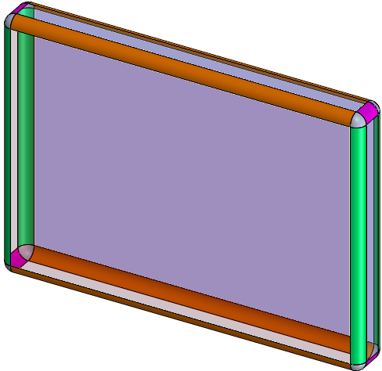
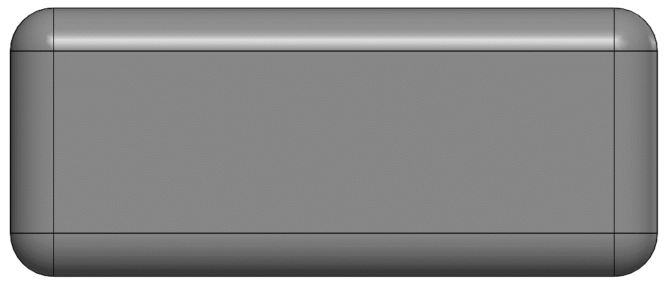
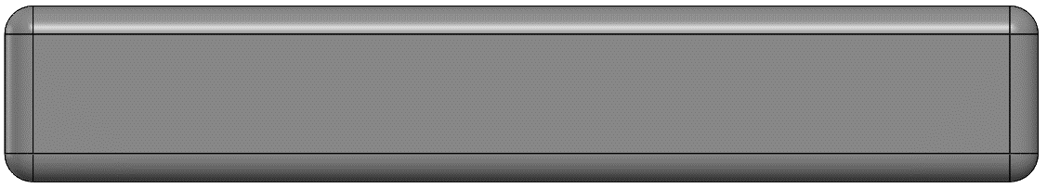
MTD | OMM Coordinate System Establishing-FAI6/FAI7
1.将产品如图平放在测量平台上；（底光30% ，倍率48X） 2.如下图避开边缘R角取线X1/Y1、X2/Y2、X3/Y3； 3.将X1摆正X轴，Y归零,线Y1 X归零 ，建立产品平面坐标系-1； 将X2摆正X轴，Y归零,线Y2 X归零 ，建立产品侧面坐标系-2； 将Y3摆正Y轴，X归零,线X3 Y归零 ，建立产品立面坐标系-3； 3. Set X1 on the X axis, set Y to zero, set line Y1 X to zero, and establish the product plane coordinate system-1; Put X2 on the X axis, Y to zero, line Y2 X to zero, and establish the product side coordinate system -2; Put Y3 on the Y-axis, X to zero, line X3 Y to zero, and establish the product facade coordinate system -3;
侧面-2
Y
Y
0.5mm
0.3mm
平面-1
立面-3
Y1
Y3
Y
0.3mm
0.5mm
0.3mm
Y2
0.3mm
0
X1
X
0
X2
X
0
X
0.5mm
0.5mm
0.3mm
0.3mm
X3
0.3mm
0.3mm
平面坐标系-1
侧面坐标系-2
立面坐标系-3

Slide 22
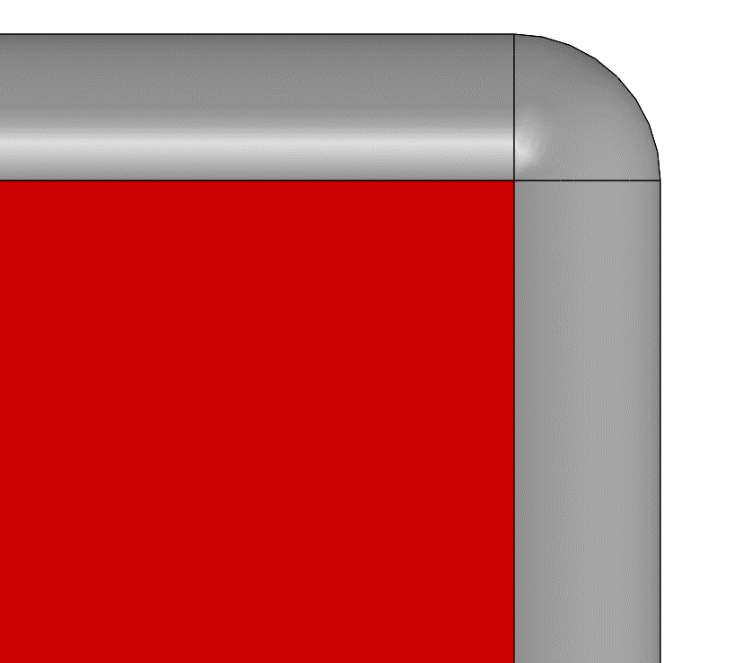
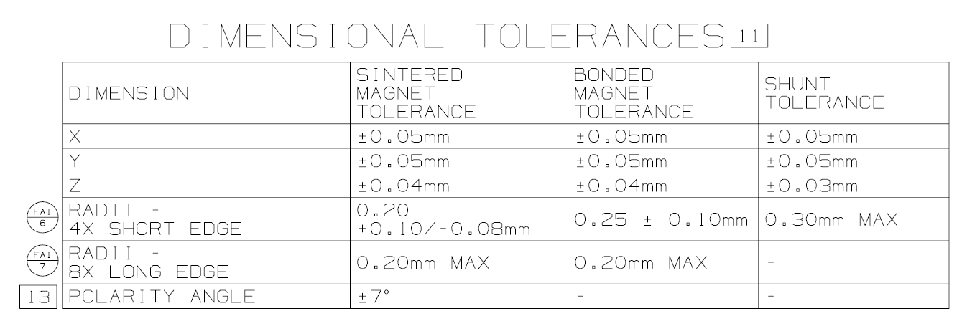
MTD | Metrology Details-平面Radius(烧结磁钢系列-镀锌)
TYP R : FAI6: 0.2 +0.1/-0.08
FAI | In-process
1 . Measurement Method ：OMM 2. Fixture ：No 3. Measurement status ：Free Measurement procedure ： 1.将产品如图平放在测量平台上，基准参考P21页平面坐标系-1;（底光30%，倍率107倍） 2.测量顺序如图(Pic 1)； 3.依圆弧过渡两直边交点为零点，选择“圆弧”工具，在X=-0.12，Y=-0.12(根据产品R角的实际规格决定)范围内抓取圆弧如图（Pic 2)，输出其半径，即FAI6-1; 4.按照同样的方法分别输出磁钢,R角2,3,4的半径，即为FAI6-2/-3/-4； 1. Place the product flat on the measuring platform as shown in the figure, with reference to page P21 Plane frame minus 1; (Bottom light 30%, magnification 48 times) 2. Measurement sequence as shown in Pic 1; 3. According to the intersection point of the two straight edges of the arc transition is zero, select the "arc" tool, grasp the arc in the range of X=-0.12, Y=-0.12(determined by the actual specifications of the R Angle of the product) as shown in FIG. (Pic 2), and output its radius, namely FAI6-1; 4. Output magnetic steel in the same way. The radius of R angles 2,3, and 4 is FAI6-2/-3/-4; | 1. Measurement Method ：OMM 2. Fixture :NO 3. Measurement status ：Free 4. Measurement procedure ：Same as the FAI
No. | FAI6-Radius |  | No. | FAI6-Radius
1 | 0.2 +0.1/-0.8 |  | 26 | 0.2 +0.1/-0.8
2 | 0.2 +0.1/-0.8 |  | 27 | 0.2 +0.1/-0.8
3 | 0.2 +0.1/-0.8 |  | 28 | 0.2 +0.1/-0.8
4 | 0.2 +0.1/-0.8 |  | 29 | 0.2 +0.1/-0.8
5 | 0.2 +0.1/-0.8 |  | 30 | 0.2 +0.1/-0.8
6 | 0.2 +0.1/-0.8 |  | 38 | 0.2 +0.1/-0.8
7 | 0.2 +0.1/-0.8 |  | 39 | 0.2 +0.1/-0.8
8 | 0.2 +0.1/-0.8 |  | 40 | 0.2 +0.1/-0.8
9 | 0.2 +0.1/-0.8 |  | 41 | 0.2 +0.1/-0.8
15 | 0.2 +0.1/-0.8 |  | 42 | 0.2 +0.1/-0.8
16 | 0.2 +0.1/-0.8 |  | 43 | 0.2 +0.1/-0.8
20 | 0.2 +0.1/-0.8 |  | 44 | 0.2 +0.1/-0.8
21 | 0.2 +0.1/-0.8 |  | 45 | 0.2 +0.1/-0.8
22 | 0.2 +0.1/-0.8 |  | 46 | 0.2 +0.1/-0.8
23 | 0.2 +0.1/-0.8 |  | 47 | 0.2 +0.1/-0.8
24 | 0.2 +0.1/-0.8 |  | 48 | 0.2 +0.1/-0.8
25 | 0.2 +0.1/-0.8 |  | 49 | 0.2 +0.1/-0.8
Y
4
1
0
X
A
-0.12mm
测试范围根据产品R角的实际规格决定
3
2
Detail A
Pic 1
Pic 2

Slide 23
MTD | Metrology Details-平面Radius(粘结磁钢系列-环氧镀层)
TYP R : FAI6: 0.25 ±0.1
FAI | In-process
1 . Measurement Method ：OMM 2. Fixture ：No 3. Measurement status ：Free Measurement procedure ： 1.将产品如图平放在测量平台上，基准参考P21页平面坐标系-1;（底光30%，倍率107倍） 2.测量顺序如图(Pic 1)； 3.依圆弧过渡两直边交点为零点，选择“圆弧”工具，在X=-0.15，Y=-0.15(根据产品R角的实际规格决定)范围内抓取圆弧如图（Pic 2)，输出其半径，即FAI6-1; 4.按照同样的方法分别输出磁钢,R角2,3,4的半径，即为FAI6-2/-3/-4； 1. Place the product flat on the measuring platform as shown in the figure, with reference to page P21 Plane frame minus 1; (Bottom light 30%, magnification 48 times) 2. Measurement sequence as shown in Pic 1; 3. According to the intersection point of the two straight edges of the arc transition is zero, select the "arc" tool, grasp the arc in the range of X=-0.15, Y=-0.15(determined by the actual specifications of the R Angle of the product) as shown in FIG. (Pic 2), and output its radius, namely FAI6-1; 4. Output magnetic steel in the same way. The radius of R angles 2,3, and 4 is FAI6-2/-3/-4; | 1. Measurement Method ：OMM 2. Fixture :NO 3. Measurement status ：Free 4. Measurement procedure ：Same as the FAI
No. | FAI6-Radius
10 | 0.25±0.1
11 | 0.25±0.1
13 | 0.25±0.1
14 | 0.25±0.1
17 | 0.25±0.1
18 | 0.25±0.1
19 | 0.25±0.1
31 | 0.25±0.1
32 | 0.25±0.1
33 | 0.25±0.1
34 | 0.25±0.1
35 | 0.25±0.1
50 | 0.25±0.1
51 | 0.25±0.1
Y
4
1
0
X
A
-0.15mm
测试范围根据产品R角的实际规格决定
3
2
Detail A
Pic 1
Pic 2

Slide 24
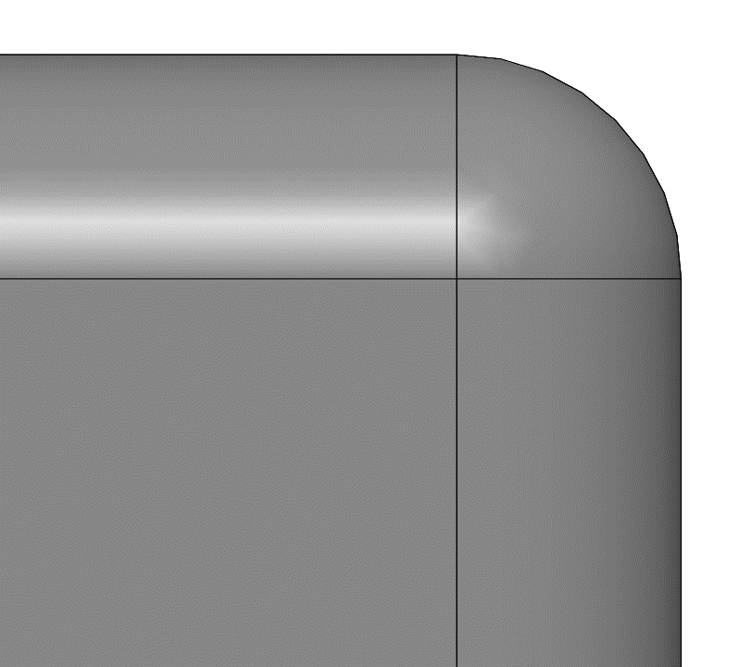
MTD | Metrology Details-侧立面Radius
TYP R : FAI7: MAX 0.2
FAI | In-process
1 . Measurement Method ：OMM 2. Fixture ：No 3. Measurement status ：Free Measurement procedure ： 1.将产品如图平放在测量平台上，基准参考P21页侧面坐标系-2;立面坐标系-3;（底光30%，倍率107倍） 2.测量顺序如图(Pic 1)； 3.依圆弧过渡两直边交点为零点，选择“圆弧”工具，在X=-0.15，Y=-0.15(根据产品R角的实际规格决定)范围内抓取圆弧如图（Pic 2)，同样方式获取R角2~8；输出其半径，即FAI7-1; 4.按照同样的方法分别输出磁钢,R角2~8的半径，即为FAI7-2~FAI7-8； 1.Place the product on the measuring platform, and refer to the side coordinate system -2 on page P21. Facade coordinate system -3; (bottom light 30%, magnification 107 times) 2.Measurement sequence as shown in Pic 1; 3.According to the intersection point of the two straight edges of the arc transition as the zero point, select the "arc" tool, grasp the arc in the range of X=-0.15, Y=-0.15(determined by the actual specifications of the R Angle of the product) as shown in Figure 2 (Pic 2), and obtain R Angle 2~8 in the same way; Print its radius, FAI7-1;4. According to the same method, the magnetic steel is output respectively. The radius of R Angle 2~8 is FAI7-2~FAI7-8; | 1. Measurement Method ：OMM 2. Fixture :NO 3. Measurement status ：Free 4. Measurement procedure ：Same as the FAI
No. | FAI7-Radius |  | No. | FAI7-Radius
1 | Max 0.2 |  | 26 | Max 0.2
2 | Max 0.2 |  | 27 | Max 0.2
3 | Max 0.2 |  | 28 | Max 0.2
4 | Max 0.2 |  | 29 | Max 0.2
5 | Max 0.2 |  | 30 | Max 0.2
6 | Max 0.2 |  | 31 | Max 0.2
7 | Max 0.2 |  | 32 | Max 0.2
8 | Max 0.2 |  | 33 | Max 0.2
9 | Max 0.2 |  | 34 | Max 0.2
10 | Max 0.2 |  | 35 | Max 0.2
11 | Max 0.2 |  | 38 | Max 0.2
13 | Max 0.2 |  | 39 | Max 0.2
14 | Max 0.2 |  | 40 | Max 0.2
15 | Max 0.2 |  | 41 | Max 0.2
16 | Max 0.2 |  | 42 | Max 0.2
17 | Max 0.2 |  | 43 | Max 0.2
18 | Max 0.2 |  | 44 | Max 0.2
19 | Max 0.2 |  | 45 | Max 0.2
20 | Max 0.2 |  | 46 | Max 0.2
21 | Max 0.2 |  | 47 | Max 0.2
22 | Max 0.2 |  | 48 | Max 0.2
23 | Max 0.2 |  | 49 | Max 0.2
24 | Max 0.2 |  | 50 | Max 0.2
25 | Max 0.2 |  | 51 | Max 0.2
Y
4
1
A
0
X
3
2
8
5
-0.15mm
测试范围根据产品R角的实际规格决定
Detail A
7
6
Pic 2
Pic 1

Slide 25
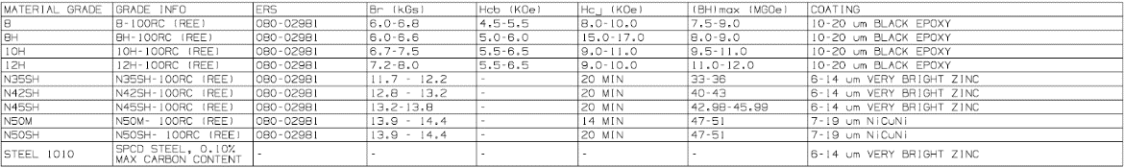
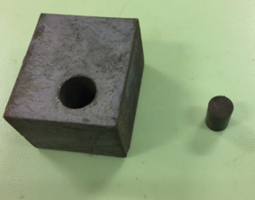

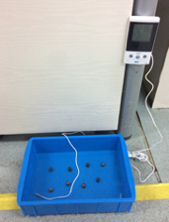
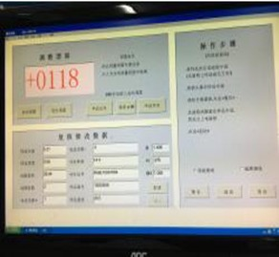
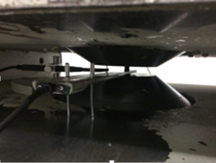

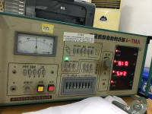
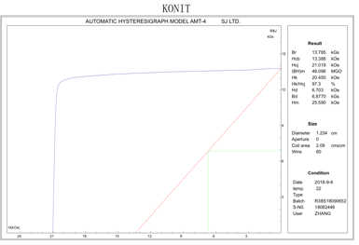
MTD | R240 Metrology Details-Magnet 099-53721-08
Magnetic Properties:N35SH: Br:11.7~12.2kGs; Hcj:20 MIN kOe;BH(Max):33~36(MGOe)
FAI | In-process
Measurement Method ：Magnetic permanent tester Fixture ：Yes 3. Measurement status ：Constrained 4. Measurement procedure ： 1.准备Block 规格长宽高：61mm*44mm*34.5mm，然后从Block边角处掏取一块Φ10mm*10mm的样柱;再准备规格为φ10mm的线圈（Pic1） 2.调试水温，温度控制在18-22度之间，将Block浸泡15分钟后取出，使用纱布擦干（Pic2） 3.根据block规格在程式中输入测试面Φ10mm（Pic3） 4.将Block放平在线圈上，再放置电磁铁的正中间，线圈两角调至平行后，压紧Block（Pic4） 5.点击操作界面“启动”键，设备自动开始测试（Pic5） 6.输出磁性曲线，记录Br， Hcj , BH max值（Pic6） 1. Prepare Block size 61mm*44mm*34.5mm; drilling a column sample of Φ10mm*10mm from the corner of block; then prepare a coil size of φ10mm (Pic1) 2. Adjust the water temperature and control it to between 18 and 22 degrees. Soak the Block with 15 minutes and remove it. 3. Input the Φ10mm into the program according to the block specification (Pic3) 4. Put Block on the coil, and then place the middle of the electromagnet. When the coil angles are adjusted to parallel, press the Block (Pic4). 5. Click the "start" button in the operation interface, and the device will start testing automatically (Pic5). 6. Output magnetic curve, record the value of Br, Hcj, BH Max (Pic6) | Measurement Method ：Magnetic permanent tester 2. Fixture ：Yes 3. Measurement status ：Constrained 4. Measurement procedure ：Same as the FAI
No. | No. | Grade | Br(KGs) | HcJ(KOe) | BH Max(MGOe)
3 | 30 | N35SH | 11.7 - 12.2 | 20 MIN | 33-36
4 | 38
8 | 39
9 | 40
15 | 41
16 | 42
29 | 49
Block
Specification
61*44*34.5mm
Sample
Specification
Φ10mm*15mm
Coil
Specification
Φ10mm
PIC1 Block/column sample and measuring Coil
PIC 2 Soak into 18℃-22℃water
PIC 3 Set Block size into program
PIC 4 Put column sample at machine plane with coil
PIC 5 Start test
PIC 6 Record the value of BR, Hcb, Hcj, BH max.
25

Slide 26
MTD | R240 Metrology Details-Magnet 099-53721-08
Magnetic Properties:N42SH: Br:12.8~13.2kGs; Hcj:20 MIN kOe;BH(Max):40~43(MGOe)
FAI | In-process
Measurement Method ：Magnetic permanent tester Fixture ：Yes 3. Measurement status ：Constrained 4. Measurement procedure ： 1.准备Block 规格长宽高：61mm*44mm*34.5mm，然后从Block边角处掏取一块Φ10mm*10mm的样柱;再准备规格为φ10mm的线圈（Pic1） 2.调试水温，温度控制在18-22度之间，将Block浸泡15分钟后取出，使用纱布擦干（Pic2） 3.根据block规格在程式中输入测试面Φ10mm（Pic3） 4.将Block放平在线圈上，再放置电磁铁的正中间，线圈两角调至平行后，压紧Block（Pic4） 5.点击操作界面“启动”键，设备自动开始测试（Pic5） 6.输出磁性曲线，记录Br， Hcj , BH max值（Pic6） 1. Prepare Block size 61mm*44mm*34.5mm; drilling a column sample of Φ10mm*10mm from the corner of block; then prepare a coil size of φ10mm (Pic1) 2. Adjust the water temperature and control it to between 18 and 22 degrees. Soak the Block with 15 minutes and remove it. 3. Input the Φ10mm into the program according to the block specification (Pic3) 4. Put Block on the coil, and then place the middle of the electromagnet. When the coil angles are adjusted to parallel, press the Block (Pic4). 5. Click the "start" button in the operation interface, and the device will start testing automatically (Pic5). 6. Output magnetic curve, record the value of Br, Hcj, BH Max (Pic6) | Measurement Method ：Magnetic permanent tester 2. Fixture ：Yes 3. Measurement status ：Constrained 4. Measurement procedure ：Same as the FAI
No. | Grade | Br(KGs) | HcJ(KOe) | BH Max(MGOe)
1 | N42SH | 12.8 – 13.2 | 20 MIN | 40-43
2
5
6
7
Block
Specification
61*44*34.5mm
Sample
Specification
Φ10mm*15mm
Coil
Specification
Φ10mm
PIC1 Block/column sample and measuring Coil
PIC 2 Soak into 18℃-22℃water
PIC 3 Set Block size into program
PIC 4 Put column sample at machine plane with coil
PIC 5 Start test
PIC 6 Record the value of BR, Hcb, Hcj, BH max.
26

Slide 27
MTD | R240 Metrology Details-Magnet 099-53721-08
Magnetic Properties:N45SH: Br:13.2~13.8kGs; Hcj:20 MIN kOe;BH(Max):42.98~45.99(MGOe)
FAI | In-process
Measurement Method ：Magnetic permanent tester Fixture ：Yes 3. Measurement status ：Constrained 4. Measurement procedure ： 1.准备Block 规格长宽高：61mm*44mm*34.5mm，然后从Block边角处掏取一块Φ10mm*10mm的样柱;再准备规格为φ10mm的线圈（Pic1） 2.调试水温，温度控制在18-22度之间，将Block浸泡15分钟后取出，使用纱布擦干（Pic2） 3.根据block规格在程式中输入测试面Φ10mm（Pic3） 4.将Block放平在线圈上，再放置电磁铁的正中间，线圈两角调至平行后，压紧Block（Pic4） 5.点击操作界面“启动”键，设备自动开始测试（Pic5） 6.输出磁性曲线，记录Br， Hcj , BH max值（Pic6） 1. Prepare Block size 61mm*44mm*34.5mm; drilling a column sample of Φ10mm*10mm from the corner of block; then prepare a coil size of φ10mm (Pic1) 2. Adjust the water temperature and control it to between 18 and 22 degrees. Soak the Block with 15 minutes and remove it. 3. Input the Φ10mm into the program according to the block specification (Pic3) 4. Put Block on the coil, and then place the middle of the electromagnet. When the coil angles are adjusted to parallel, press the Block (Pic4). 5. Click the "start" button in the operation interface, and the device will start testing automatically (Pic5). 6. Output magnetic curve, record the value of Br, Hcj, BH Max (Pic6) | Measurement Method ：Magnetic permanent tester 2. Fixture ：Yes 3. Measurement status ：Constrained 4. Measurement procedure ：Same as the FAI
No. | No. | Grade | Br(KGs) | HcJ(KOe) | BH Max(MGOe)
20 | 28 | N45SH | 13.2 – 13.8 | 20 MIN | 42.98-45.99
21 | 43
22 | 44
23 | 45
24 | 46
25 | 47
26 | 48
27
Block
Specification
61*44*34.5mm
Sample
Specification
Φ10mm*15mm
Coil
Specification
Φ10mm
PIC1 Block/column sample and measuring Coil
PIC 2 Soak into 18℃-22℃water
PIC 3 Set Block size into program
PIC 4 Put column sample at machine plane with coil
PIC 5 Start test
PIC 6 Record the value of BR, Hcb, Hcj, BH max.
27

Slide 28
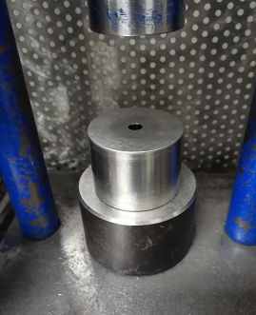

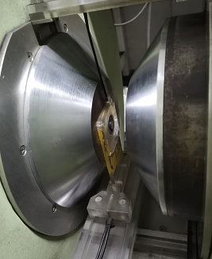

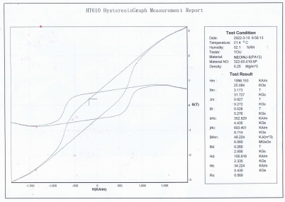
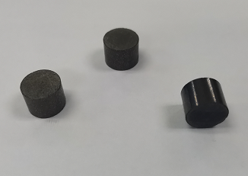
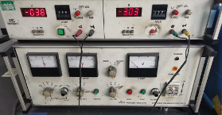
MTD | R240 Metrology Details-Magnet 099-53721-08
MATERIAL PROPERTIES:8-100RC: Br:6.0~6.8kGs;Hcb:4.5~5.5kOe;Hcj:8.0~10.0kOe;BH(Max):7.5~9.0(MGOe)
FAI | In-process
1. Measurement Method ：Magnetic permanent tester 2. Fixture ：/ 3. Measurement status ：Free 4. Measurement procedure ： Same as the FAI 使用模具准备规格为Φ10mm*10mm的样柱(Pic1&Pic2); 根据测试样柱的规格在程式中输入测试面直径10mm（Pic3） 将样柱放平在线圈上，再放置电磁铁的正中间，线圈两角调至平行后，压紧样柱（Pic4） 点击操作界面“启动”键，设备自动开始测试（Pic5） 输出磁性曲线，记录Br，Hcb, Hcj , BH max值（Pic6） Prepare a column sample of Φ10mm*10mm by the column mold;(Pic1&Pic2) Input the diameter 10mm into the program according to the column sample specification (Pic3) Put column sample on the coil, and then place the middle of the electromagnet. When the coil angles are adjusted to parallel, press the column sample (Pic4). Click the "start" button in the operation interface, and the device will start testing automatically (Pic5). Output magnetic curve, record the value of Br, Hcb, Hcj, BH Max (Pic6) | 1. Measurement Method ：Magnetic permanent tester 2. Fixture ：/ 3. Measurement status ：Free 4. Measurement procedure ：Same as the FAI
No. | Grade | Br(KGs) | Hcb（KOe） | HcJ(KOe) | BH Max(MGOe)
11 | 8-100RC | 6.0-6.8 | 4.5-5.5 | 8.0-10.0 | 7.5-9.0
34
35
Width-Center
Length-Center
PIC 1 column mold
PIC 2 Φ10mm*10mm samples
PIC 3 Set column sample size into program
PIC 4 Put column sample at machine plane
PIC 5 Start test
PIC 6 Record the value of Br, Hcb, Hcj, BH max.
28

Slide 29
MTD | R240 Metrology Details-Magnet 099-53721-08
MATERIAL PROPERTIES:12H-100RC: Br:7.2~8.0kGs;Hcb:5.5~6.5kOe;Hcj:9.0~10.0kOe;BH(Max):11.0~12.0(MGOe)
FAI | In-process
1. Measurement Method ：Magnetic permanent tester 2. Fixture ：/ 3. Measurement status ：Free 4. Measurement procedure ： Same as the FAI 使用模具准备规格为Φ10mm*10mm的样柱(Pic1&Pic2); 根据测试样柱的规格在程式中输入测试面直径10mm（Pic3） 将样柱放平在线圈上，再放置电磁铁的正中间，线圈两角调至平行后，压紧样柱（Pic4） 点击操作界面“启动”键，设备自动开始测试（Pic5） 输出磁性曲线，记录Br，Hcb, Hcj , BH max值（Pic6） Prepare a column sample of Φ10mm*10mm by the column mold;(Pic1&Pic2) Input the diameter 10mm into the program according to the column sample specification (Pic3) Put column sample on the coil, and then place the middle of the electromagnet. When the coil angles are adjusted to parallel, press the column sample (Pic4). Click the "start" button in the operation interface, and the device will start testing automatically (Pic5). Output magnetic curve, record the value of Br, Hcb, Hcj, BH Max (Pic6) | 1. Measurement Method ：Magnetic permanent tester 2. Fixture ：/ 3. Measurement status ：Free 4. Measurement procedure ：Same as the FAI
No. | No. | Grade | Br(KGs) | Hcb（KOe） | HcJ(KOe) | BH Max(MGOe)
10 | 31 | 12H-100RC | 7.2-8.0 | 5.5-6.5 | 9.0-10.0 | 11.0-12.0
13 | 32
14 | 33
17 | 50
18 | 51
19
Width-Center
Length-Center
PIC 1 column mold
PIC 2 Φ10mm*10mm samples
PIC 3 Set column sample size into program
PIC 4 Put column sample at machine plane
PIC 5 Start test
PIC 6 Record the value of Br, Hcb, Hcj, BH max.
29

Slide 30
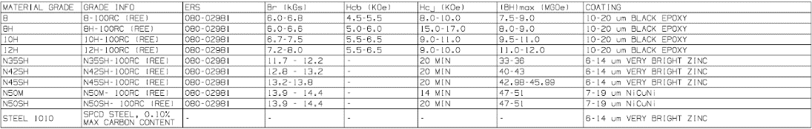

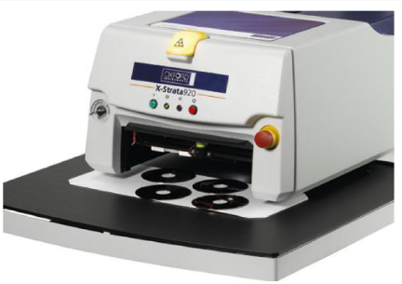
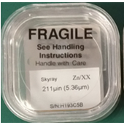
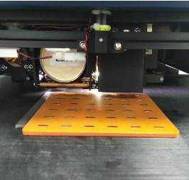
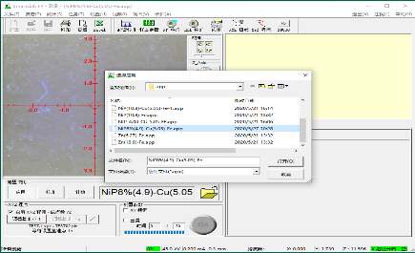
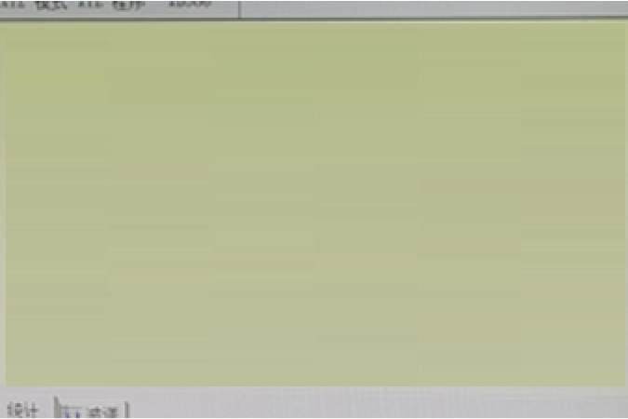
MTD | R240 Metrology Details-Magnet 099-53721-08
Plating Thickness - Magnet: ZN(N35H/N42H/N45H) 6-14μm
FAI | In-process
1 . Measurement Method ：X射线荧光镀层测厚仪 2. Fixture ：No 3. Measurement status ：Free Measurement procedure ： 1. 打开软件程序； 2. 点检标样； 3. 将测量样品放入样品腔中，并将产品平放使激光点在产品的标记位置 (P1)，选择对应的工作曲线模式，点击开始按钮，输入量测相对应的资料，点击“确定”执行量测 ，并记录1个数值. Open the software program; 2. Check the standard sample; 3. Put the measured sample into the sample chamber, and lay the product flat so that the laser point is in the marked position of the product (P1), select the corresponding working curve mode, click the Start button, enter the corresponding data of the measurement, click "OK" to perform the measurement, and record a value. | 1. Measurement Method ：X射线荧光镀层测厚仪 2. Fixture :No 3. Measurement status ：Free 4. Measurement procedure ：Same as the FAI
No. | Grade |  | No. | Grade |  | No. | Grade |  | Plating Thickness
1 | N42SH |  | 22 | N45SH |  | 42 | N35SH |  | 6-14 µm Plating ZN
2 | N42SH |  | 23 | N45SH |  | 43 | N45SH
3 | N35SH |  | 24 | N45SH |  | 44 | N45SH
4 | N35SH |  | 25 | N45SH |  | 45 | N45SH
5 | N42SH |  | 26 | N45SH |  | 46 | N45SH
6 | N42SH |  | 27 | N45SH |  | 47 | N45SH
7 | N42SH |  | 28 | N45SH |  | 48 | N45SH
8 | N35SH |  | 29 | N35SH |  | 49 | N35SH
9 | N35SH |  | 30 | N35SH
15 | N35SH |  | 38 | N35SH
16 | N35SH |  | 39 | N35SH
20 | N45SH |  | 40 | N35SH
21 | N45SH |  | 41 | N35SH
P1
校准
测试
8.69 微米 Zn
选择曲线
设备
标准块
放置产品
选择程序
结果

Slide 31


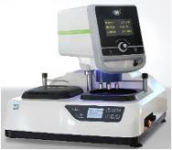

















MTD | R240 Metrology Details-Magnet 099-53721-08
Epoxy thickness:8-100RC/12H-100RC: 10~20μm
FAI | In-process
1. Measurement Method ：Metallographic Microscope / Cross-Section 2. Fixture :/ 3. Measurement status ：Free 4. Measurement procedure ： 1.制作镶样块：按Step1~Step4作业（Pic1）； 2.磨抛：按Step5~Step6作业（Pic2）； 3.测量：按Step7~Step9作业（Pic3）； 4.记录数据：记录测试3个数据的平均值； 1. Make insert blocks: according to Step1 to Step 4(Pic1); 2. Grinding: work according to Step 5~Step 6 (Pic2); 3. Measurement: work according to Step 7 to Step9 (Pic3); 4. Record data: record the average value of three test data; | 1. Measurement Method ：Metallographic Microscope / Cross-Section 2. Fixture :/ 3. Measurement status ：Free 4. Measurement procedure ：Same as the FAI
No. | Grade | Plating Thickness
10 | 12H | Epoxy:10-20
11 | 8 | Epoxy:10-20
13 | 12H | Epoxy:10-20
14 | 12H | Epoxy:10-20
17 | 12H | Epoxy:10-20
18 | 12H | Epoxy:10-20
19 | 12H | Epoxy:10-20
31 | 12H | Epoxy:10-20
32 | 12H | Epoxy:10-20
33 | 12H | Epoxy:10-20
34 | 8 | Epoxy:10-20
35 | 8 | Epoxy:10-20
50 | 12H | Epoxy:10-20
51 | 12H | Epoxy:10-20
1.5mm
Polishing machine
Grinding motion: Grinding upward
from Y0,grinding 1.5mm
Step 5. Coarse grinding: grinding disc speed 500 RPM,Indenter speed 75 RPM/min, pressure 45N,Use Size 240-1000-2400-3000 sandpaper in turn
Step 6. Polishing: Grinding disc speed 500 RPM,,Indenter speed 75 RPM/min,pressure 45N,Using a
polishing cloth to do polish
Test position of main surface
Test position of side surface
Test points
Test the center
of the long edge
Cold inlay glue/measuring cup/mold
Step1. Cut off 9mm at the length direction
Step2. Place the sample vertically in the mold along the length direction
100X
200X
Step3. Prepare 20ml of glue A (epoxy resin) and 10ml of glue B (curing agent), and fully stir A/B glue clockwise
Step4. Pour the mixed glue into the product mould, stand still for 2.5H, take it out of the mould
Metalloscope
Step7. Place the polished sample blocks on the measuring platform
Step 8. Enlarge 100X to
determine the test position
Step 9. Magnify 200X to test coating thickness, take the average value of 3 points（interval 3mm）, test center position of side and upper and lower planes of each sample, refer to the schematic diagram of test points
*NOTE:NO.19长度超过20mm时需裁剪镶嵌

Slide 32




MTD | R240 Metrology Details-Magnet 099-53721-08
MAGNET SST: ＞24H
FAI | In-process
1 . Measurement Method ：SST Tester 2. Fixture ：No 3. Measurement status ：Free 4. Measurement procedure ： a.设备点检(图1)和溶液制备：5%氯化钠+95%去离子水，将氯化钠溶液放入溶液桶中，PH 试纸测试PH值标准6.5-7.2。 b.测试条件：在35°C下设置试验室，在47°C下设置饱和空气桶，压力0.1MPa(图2)。 c.产品垂直放置：确保样品表面无划痕、气泡、铁锈等异常，将产品32片/批垂直放置(图3)在板上夹具1(材料橡胶磁铁、塑料袋真空包装），然后每两片产品之间保持20毫米的间距(图4) d.橡胶磁板放置(图4): 将装有样品的背板倾斜到三脚架上夹具2,底板与垂直方向的夹角为15°-30°,符合ASTM B117-03标准。 e.判定:试验后取出样品,用纯水冲洗2次,每次至少10秒，然后用吹风机微风吹干；检查表面有无剥落、气泡、锈迹等(图5)。 a.Check of equipment (PIC 1) and solution preparation: 5% NaCl+95% deionized water (DI water), Measuring PH value with PH pen, PH 6.5-7.2 is OK; Put salt solution into the NaCl solution barrel. Put DI water into the saturated air barrel;. b.Test Condition:Set up test chamber 35°C and saturated air barrel at 47°C,Pressure 0.1MPa (PIC 2). c.Make sure the surface of samples no abnormalities, such as scratch, bubble and rust etc，Put product 32 pieces/Batch , firstly each product is placed vertically (PIC 3) on the plate-Fixture 1 ( material rubber magnet, Vacuum Packaging of Plastic Bags and paper) and keep 20mm space between each part (PIC 4) d.Then lean backplane loaded(PIC4) with samples on the tripod-Fixture 2The angle between the backplane and the vertical direction is 15°-30° from ASTM B117-03. e.Judgement: Take the samples out after salt spray test,Rinse 2 times with pure water for at least 10 seconds each time and then dry with a light breeze from a hair dryer;Check whether there are peeling, bubbles, rust and etc. on the surface (PIC 5). | 1 . Measurement Method ：SST Tester 2. Fixture : No 3. Measurement status ：Free 4. Measurement procedure ：Same as the FAI
表面无断裂，剥落，气泡等OK
放大图
20mm
表面断裂，剥落，气泡等NG
PIC 2 Test condition
Product ： Not Magnetized
PIC 3 ： Placed vertically
PIC 5： Judgement

Slide 33












MTD | R240 Metrology Details-Magnet 099-53721-08
Cross Hatch：ASTM 4B
FAI | In-process
1. Measurement Method ：Cross Hatch 2. Fixture ：J-R240-2# 3. Measurement status ：Constrained 4. Measurement procedure: 1.治具/工具/产品准备：划格刀(图1)、3M胶带(图2)、辅助治具(图3)、网格板(图4),检查产品（带漆层）表⾯确保产品表⾯⽆起泡、镀层脱落、裂纹等现象将产品放入辅助治具板内(图5)； 2.切割：按压网格板在产品表面,使⽤划格⼑顺着网格在产品表⾯交叉切割 (图6), X方向划*条线(根据产品的长定义)，Y方向划*条线(根据产品的宽定义), 每⼀条划痕线应深及镀层的基体（图7）; 3.测试：使⽤3M胶带牢牢粘住被测试的产品⼩⽹格位置，⼿指搓揉胶带表⾯，以加⼤胶带与被测区域的接触⾯积(图8)，放置90+/-30秒，⽽后⽤⼿抓住胶带的⼀端，并以尽可能接近180°⻆度快速撕开胶带(图9)。 4.判断：按照对⽐图(图10)目视检查镀层脱离⾯积进⾏判定; 1. Fixture/tool/product preparation: grid knife (Figure 1), 3M tape (Figure 2), auxiliary fixture (Figure 3), grid plate (Figure 4), check the surface of the product (with paint layer) to ensure that there is no bubbling, coating off, crack and other phenomena on the surface of the product and put the product into the auxiliary fixture plate (Figure 5); 2. Cutting: press the grid plate on the surface of the product, and use the grid knife to cross the product surface along the grid (Figure 6). Draw a line in the X direction (defined by the length of the product), draw a line in the Y direction (defined by the width of the product), and each scratch line should be deep to the substrate of the coating (Figure 7); 3. Test: Firmly stick the small grid position of the tested product with 3M tape, rub the surface of the tape with your fingers to increase the contact area between the tape and the tested area (Figure 8), place it for 90+/-30 seconds, and then grasp the end of the tape with your hand and quickly tear the tape at an Angle as close to 180° as possible (Figure 9). 4. Judgment: According to the comparison diagram (Figure 10), visually inspect the area of coating detachment to determine; | 1. Measurement Method ：Cross Hatch 2. Fixture ：J-R240-2# 3. Measurement status ：Constrained 4. Measurement procedure ：Same as the FAI
划格刀
3mm胶带
辅助治具
划格板间隔1mm
Pic1
Pic 2
Pic 3
Pic 4
Pic 5
Pic 6
Pic 7
Pic 8
OK
NG
Pic 10 Judgement
Pic 9

Slide 34




MTD | R240 Metrology Details-Magnet 099-53721-08
SURFACE ENERGY : ＞34mN/m
FAI | In-process
1. Measurement Method ：Dyne Pen 2. Fixture ：/ 3. Measurement status ：Free 4. Measurement procedure： 达因笔：型号选择使用34# (图1) 。 测试样品 (图2) ：测试样品表面 (最大平面) ,用干净的夹子取样，防止污染产品。把样品放在干净桌子上，用戴指套的手指按压样品末端，用达因笔在样品表面画一条线，测线长度至少应为样品长度的2/3。 在3秒内观察划线的变化:如果在3秒内测线均匀分布且没有收缩，则判断正常-OK (图3) 。 如果标记在3秒内立即收缩形成珠，则表面张力低于34，判断-NG (图4) 。 a. Dyne pen: selection model uses 34# (PIC 1) . b. Magnet sample (PIC2) : Test sample surface (maximum plane) , take the samples with clean clamp to prevent contamination of product. Place the sample on a clean table, Fix the end of the sample with a gloved finger, Use dyne pen mark a line on the surface of the sample. The length of the line should be at least 2/3 of the sample length. c. Observe line changes within 3 seconds. If the line are evenly distributed without shrink, it is OK. (PIC 3) d. If the mark shrinks to form beads immediately in 3 seconds, the surface tension is low than the 34#, it is NG. (PIC 4) | 1. Measurement Method ：Dyne Pen 2. Fixture ：/ 3. Measurement status ：Free 4. Measurement procedure ：Same as the FAI
OK
NG
PIC2 Magnet Sample
PIC3 without shrink within 3 seconds, Judgement-OK
PIC4 Shrink immediately in 3 seconds, Judgement -NG.
PIC1 Dyne Pen 34#

Slide 35









MTD | R240 Metrology Details-Magnet 099-53721-08
Heat Quench :150℃/1H
FAI | In-process
1 . Measurement Method ：Oven 2. Fixture ：/ 3. Measurement status ：Free 4. Measurement procedure ： 1.打开烤箱，参考ERS文件镀层(镀锌)设定温度150℃/1H(Pic1)； 2.放磁钢到烘箱 (Pic2) ：将样品平放在干净的板上，确保样品表面无断裂、裂纹、剥落、气泡等异常。当烤箱温度稳定后，将装有样品的平板放入烤箱1小时； 3.迅速将样品放入±2℃冰水混合物(Pic3)，持续时间小于15秒； 4.检查和判定：将磁钢⽤镊⼦从⽔中取出，⽤⼲净无尘布擦⼲ (Pic4) ，检查表面有无断裂、裂纹、剥落、气泡等 (Pic5). 1. Open the oven and set the temperature 150℃/1H(Pic1) according to ERS files for coating (galvanizing); 2. Put the magnetic steel into the oven (Pic2) : place the sample flat on the clean plate to ensure that there is no fracture, crack, peeling, bubble and other anomalies on the surface of the sample. When the oven temperature was stable, the plate containing the sample was placed in the oven for 1 hour. 3. Quickly put the sample into the ±2℃ ice water mixture (Pic3) for less than 15 seconds; 4. Inspection and determination: take the magnetic steel out of the water with tweezers, dry it with a clean dustless cloth (Pic4), and check the surface for fracture, crack, peeling, bubbles, etc. (Pic5). | 1 . Measurement Method ：Oven 2. Fixture : / 3. Measurement status ：Free 4. Measurement procedure ：Same as the FAI
Measurement
OK
NG
PIC1 Plating NICUNI Oven-Set 250 ℃
Plating ZN Oven-Set 150 ℃
PIC2 Put Magnet to Oven
PIC 3 After 1 hour,Place the magnet
in ice water mixture at +/-2 ° C
PIC 4 Pick out with tweezers and wipe
clean with a dust-free cloth
PIC 5 Check and Judgement
35

Slide 36


MTD | R240 Metrology Details-Magnet 099-53721-08
Heat Quench :250℃/1H
FAI | In-process
1 . Measurement Method ：Oven 2. Fixture ：/ 3. Measurement status ：Free 4. Measurement procedure ： 1.打开烤箱，参考ERS文件镀层(黑色环氧)设定温度250℃/1H(Pic1) ； 2.放磁钢到烘箱 (Pic2) ：将样品平放在干净的板上，确保样品表面无断裂、裂纹、剥落、气泡等异常。当烤箱温度稳定后，将装有样品的平板放入烤箱1小时； 3.迅速将样品放入±2℃冰水混合物(Pic3)，持续时间小于15秒； 4.检查和判定：将磁钢⽤镊⼦从⽔中取出，⽤⼲净无尘布擦⼲ (Pic4) ，检查表面有无断裂、裂纹、剥落、气泡等 (Pic5). 1. Turn on the oven and refer to the ERS file for the coating (black epoxy) settings - set the temperature to 250°C for 1 hour (Pic1); 2. Put the magnetic steel into the oven (Pic2) : place the sample flat on the clean plate to ensure that there is no fracture, crack, peeling, bubble and other anomalies on the surface of the sample. When the oven temperature was stable, the plate containing the sample was placed in the oven for 1 hour. 3. Quickly put the sample into the ±2℃ ice water mixture (Pic3) for less than 15 seconds; 4. Inspection and determination: take the magnetic steel out of the water with tweezers, dry it with a clean dustless cloth (Pic4), and check the surface for fracture, crack, peeling, bubbles, etc. (Pic5). | 1 . Measurement Method ：Oven 2. Fixture : / 3. Measurement status ：Free 4. Measurement procedure ：Same as the FAI
Measurement
OK
NG
PIC1 Plating NICUNI Oven-Set 250 ℃
Plating ZN Oven-Set 150 ℃
PIC2 Put Magnet to Oven
PIC 3 After 1 hour,Place the magnet
in ice water mixture at +/-2 ° C
PIC 4 Pick out with tweezers and wipe
clean with a dust-free cloth
PIC 5 Check and Judgement
36

